Slide 1
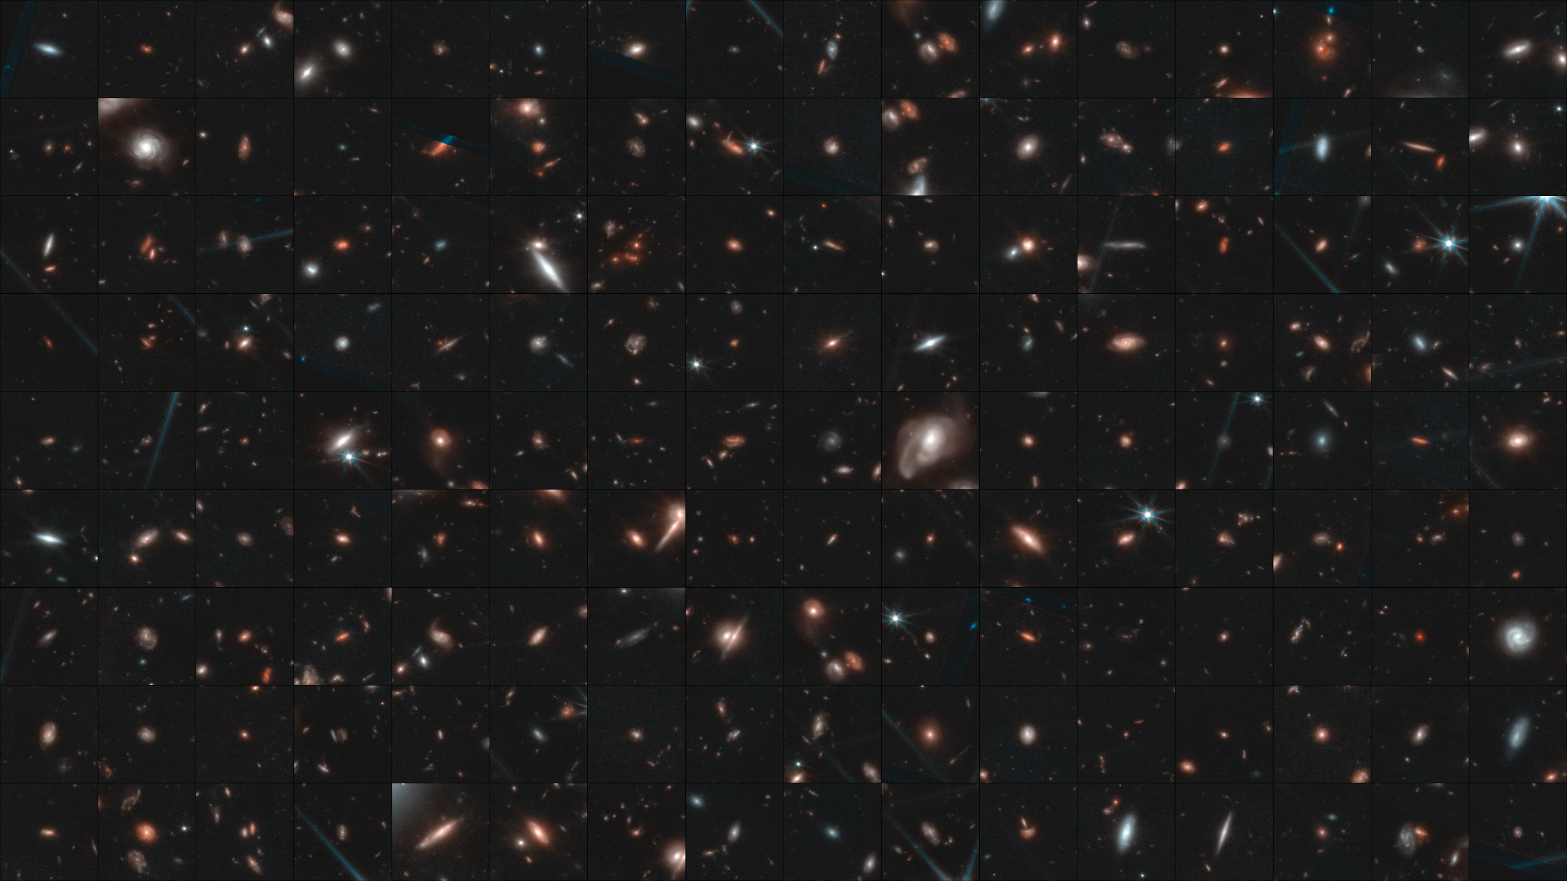




Discovery of NIR-Variable Objects in the JWIDF
Gibson B. Bowling
Mentor: Dr. Rogier A. Windhorst
School of Earth and Space Exploration, Arizona State University
AZSGC Symposium
April 18, 2026
Notes:
Background: collage 37688

Slide 2
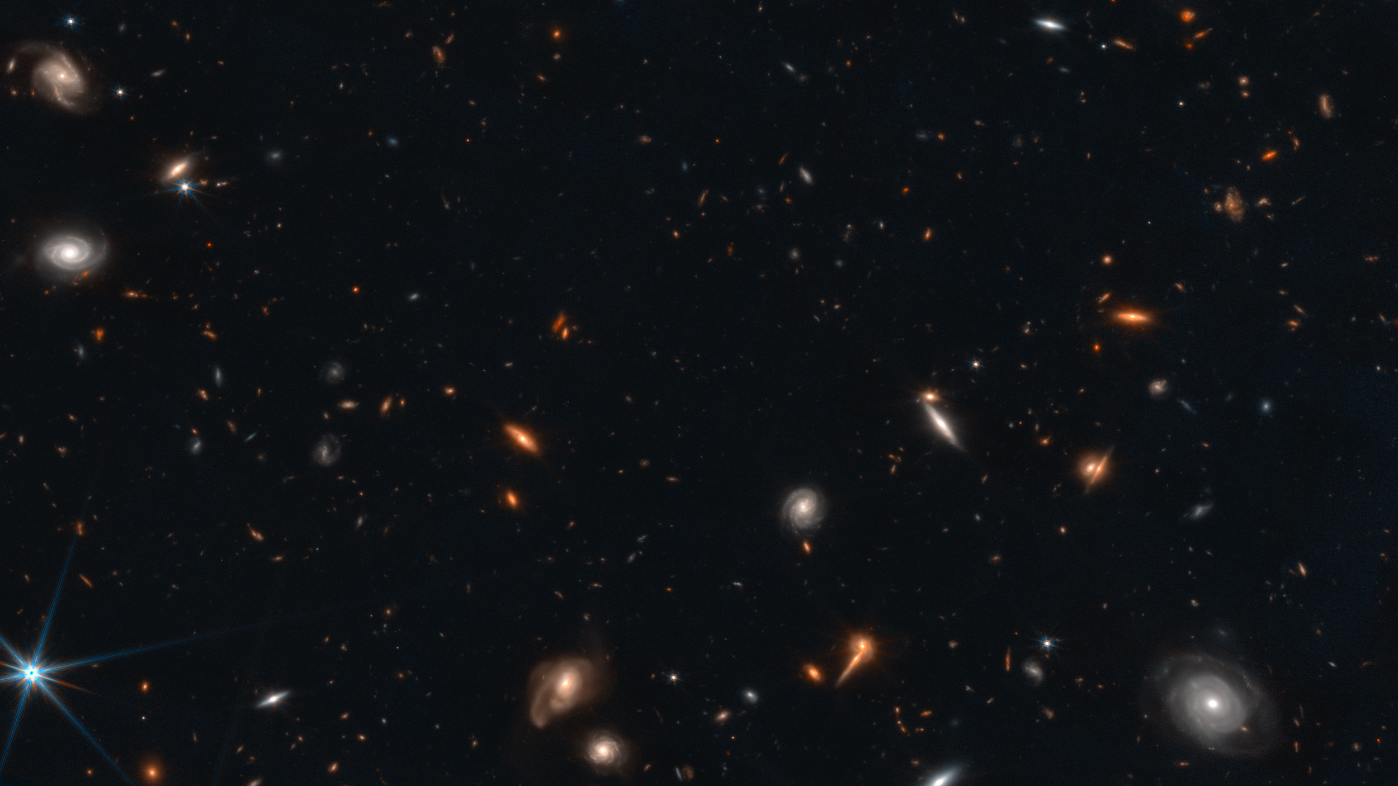
Galaxies, Variability, and the JWIDF
This is the JWST/NIRCam view of the IRAC Dark Field, or JWIDF
Circled objects are galactic stars, almost everything else is a galaxy
Three epochs’ worth of JWIDF
data → possibility to leverage JWST’s sensitivity and angular resolution to find variable objects
G. B. Bowling (ASU)
gbbowlin@asu.edu

Slide 3
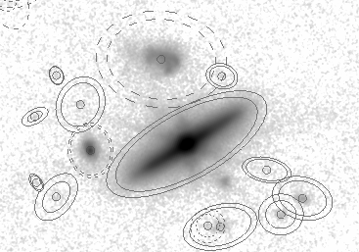
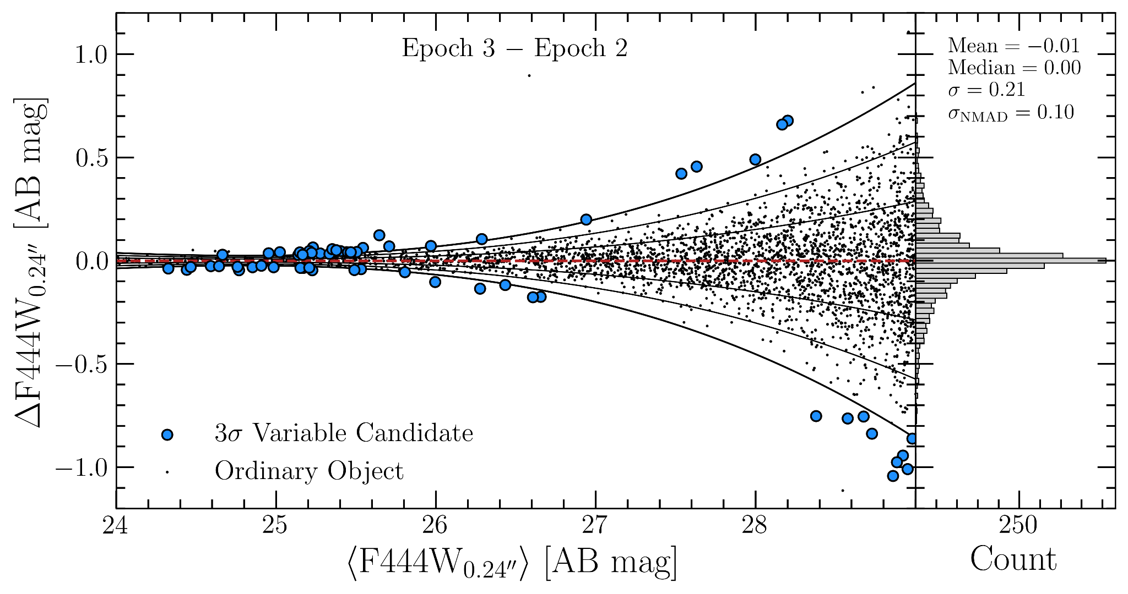
Measurement and Candidate Selection
Measurements of each epoch at 4.4 μm of were taken using 0.24ʺ Kron-like apertures with aggressive deblending
Epoch-wise magnitude differences were computed down to m_{AB} = 29 — objects with
3σ+ Δmag at their magnitudes formed a sample of variable candidates
G. B. Bowling (ASU)
gbbowlin@asu.edu

Slide 4
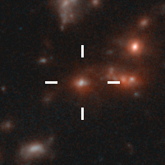
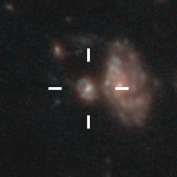
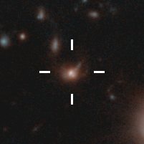
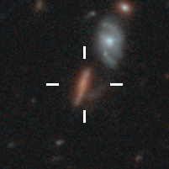
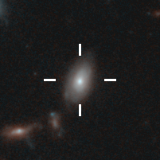
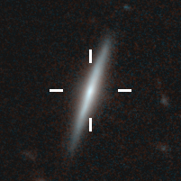
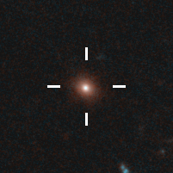
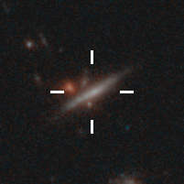
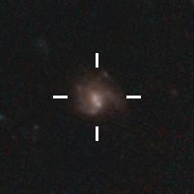
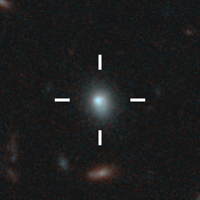
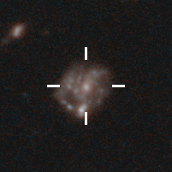
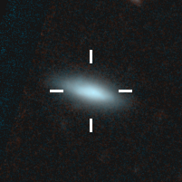
The Variability Catalog
Mergers — give rise to so-called “violent relaxation,” gas inflows that promote starbursts
Nuclear activity — short-timescale flickering of bright cores point to AGN activity (more later…)
Off-center “spots” — bright point-sources in the disks of galaxies, possible SNes?
G. B. Bowling (ASU)
gbbowlin@asu.edu

Slide 5
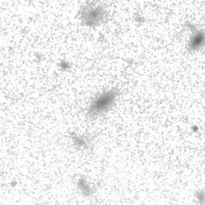
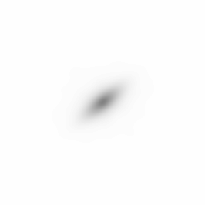
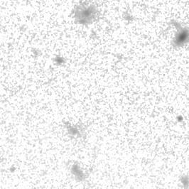
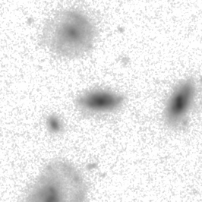
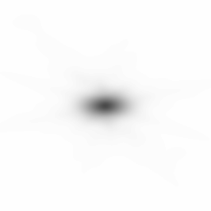
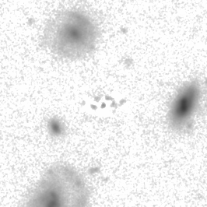
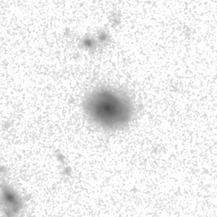

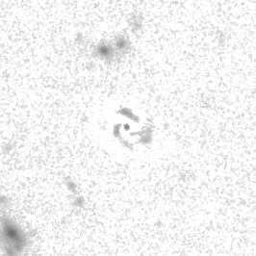
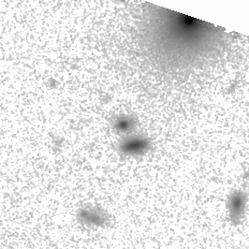
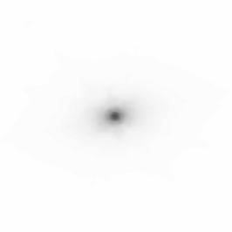
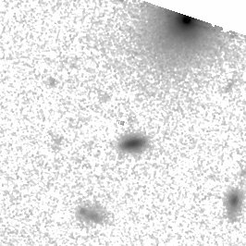
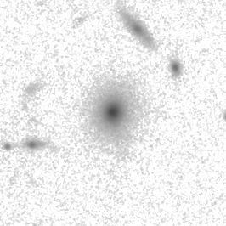
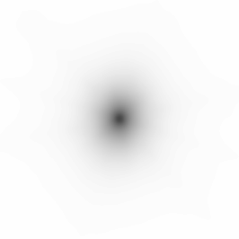
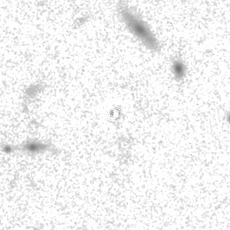
Morphologies and Colors
Candidates’ light profiles are generally Sérsic-like, but some objects look like point-sources…
G. B. Bowling (ASU)
gbbowlin@asu.edu

Slide 6
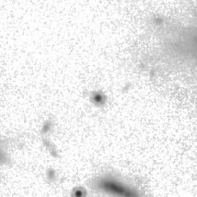
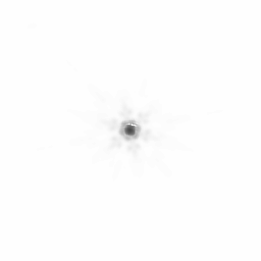

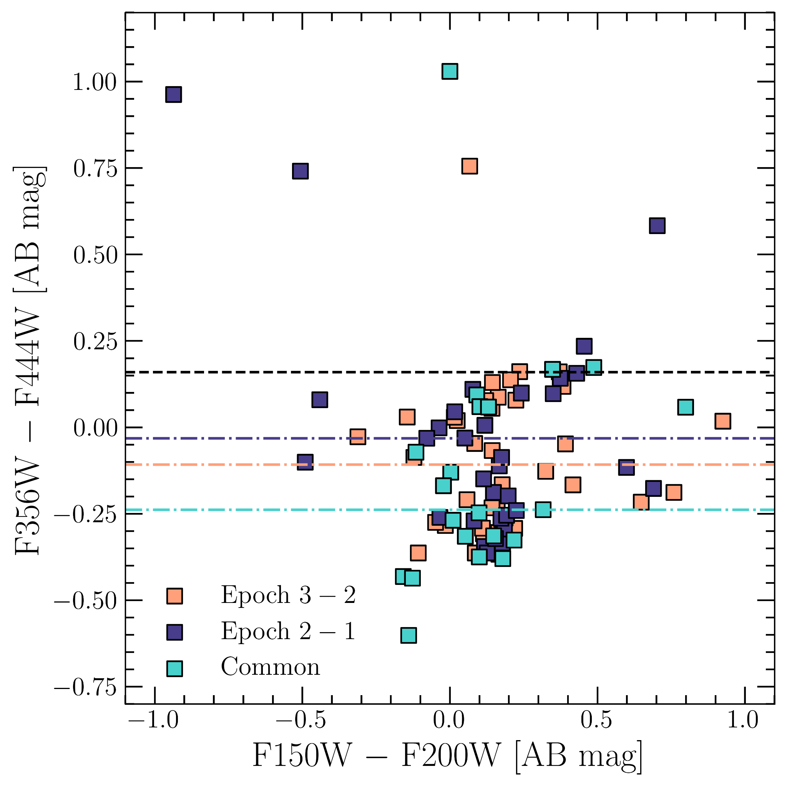
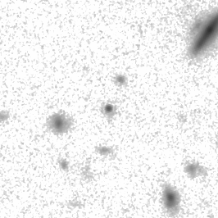
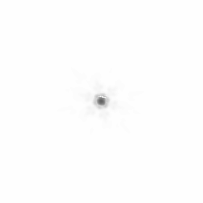
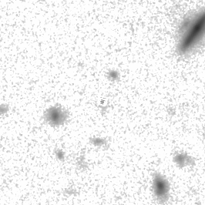
Morphologies and Colors
Indeed, a handful of objects are described as bona fide point-sources, instead of compact Sérsic profiles. Their colors identify them as strong AGN candidates…
G. B. Bowling (ASU)
gbbowlin@asu.edu

Slide 7
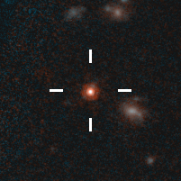
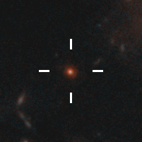
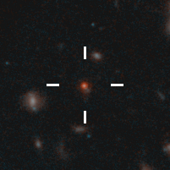
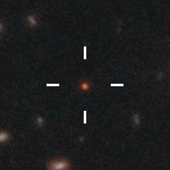
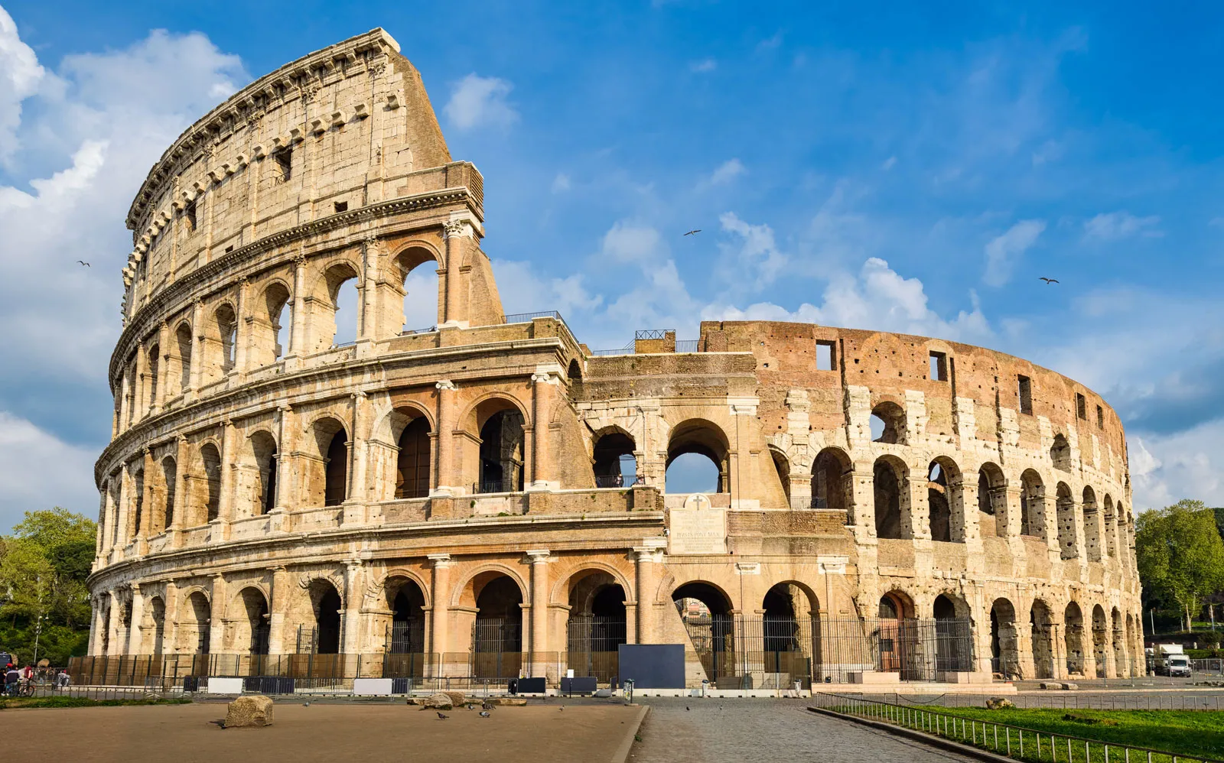
High-z Quasars?
Some objects have
Detections at 4.4 μm & red colors
Variability at 4.4 μm
Structural parameters ⇒ physical compactness
Point-source light profiles
Walk and talk like high-z quasars so far… unable to identify as quasars for sure.
JWST/MIRI? IR spectroscopy?
G. B. Bowling (ASU)
gbbowlin@asu.edu

Slide 8
Conclusions
JWST/NIRCam is uniquely suited to probe faint magnitudes at high resolution → perfect tool for studying NIR variability
We find a conservative sample of 21 3σ+ 4.4 μm-variabile candidates containing mergers, galaxies with nuclear flickering, red point-sources, and possible SNes
Colors corroborate variability in identifying a strong sample of AGN — point-sources with AGN-like colors are consistent with high-z quasars
Longer-wavelength observations (e.g., JWST/MIRI or IR spectroscopy) are required for further analysis
G. B. Bowling (ASU)
gbbowlin@asu.edu

Slide 9

Acknowledgements
Dr. Rogier A. Windhorst, Dr. Seth H. Cohen, Rafael Ortiz III, Dr. Haojing Yan, and the PEARLS Team
The Arizona NASA Space Grant Consortium
Software:
Astropy — Astropy Collaboration+25
SourceExtractor — Bertin+96
Photutils — Bradley+25
GALFIT — Peng+10
Trilogy — Coe+15
G. B. Bowling (ASU)
gbbowlin@asu.edu

Slide 10
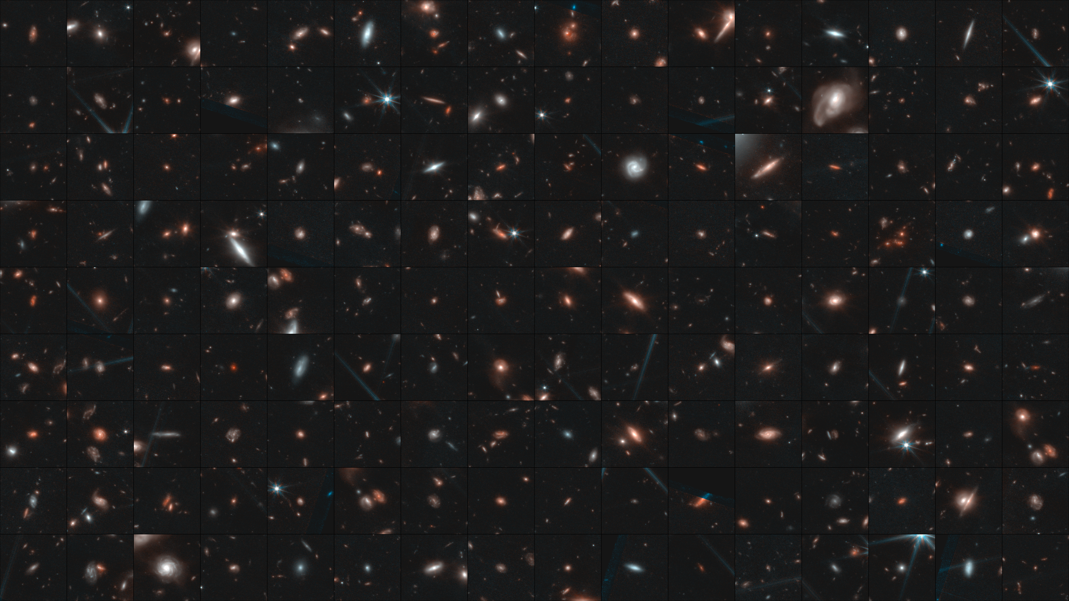
Thank you!
G. B. Bowling (ASU)
gbbowlin@asu.edu
Notes:
Background: collage 13649

